Slide 1
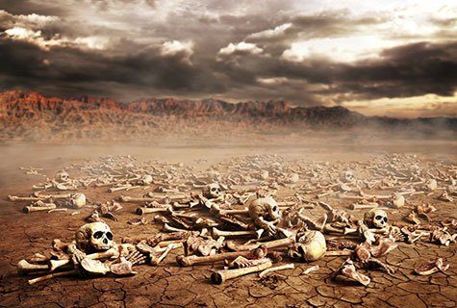
Ezekiel
“Ye Shall Know That I Am The Lord”

Slide 2
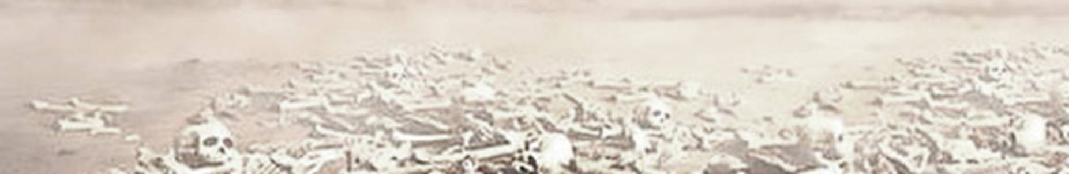
Ezekiel
Lessons 15 – Ezekiel 29-32
Seven Prophecies Against Egypt
“The Word of the Lord came to me” occurs 7 times in these four chapters.
Six of these are dated during Jehoiachin’s captivity
  29:1 -- 10th year, 10th month, 12th day -- 587 BC
  30:20 -- 11th year, 1st month, 7th day -- 586 BC
  31:1 -- 11th year, 3rd month, 1st day -- 586 BC
  32:1 -- 12th year, 12th month, 1st day -- 585 BC
  32:17 -- 12th year, 15th day -- 585 BC
  29:17 -- 27th year, 1st month, 1st day -- 570 BC
Jerusalem besieged on 9th year, 10th month, 10th day, fell on 11th year, 4th month, 9th day (2 Kings 25:1-3)

Slide 3
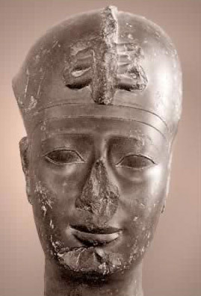
Ezekiel
Lessons 17 – Ezekiel 29-32
The Sins and punishments of Egypt (29:1-16)
  Pharaoh (Hophra) was filled with pride and would be brought low (cf. Jeremiah 44:30)
      Hophra (Apries) is known outside the Bible “in Egyptian inscriptions…with reflections in Babylonian inscriptions regarding Nebuchadnezzar’s defeat of Hophra in 572 and replacing him on the throne of Egypt with a general, Amasis, who later rebelled against Babylonia and was suppressed” (“People in the Bible Confirmed Archaeologically, BAR, 4/12/17)

Slide 4
Ezekiel
Lessons 17 – Ezekiel 29-32
The Sins and punishments of Egypt (29:1-16)
  Egypt had given false hope and unreliable support to Israel (29:6-7, see Isaiah 36:6; Jeremiah 37:5-7)
  Egypt would be desolate for 40 years (29:8-14)
  It would never again rise to its previous prominence (29:15-16)
Notes:
Isaiah 36:6 Look! You are trusting in the staff of this broken reed, Egypt, on which if a man leans, it will go into his hand and pierce it. So is Pharaoh king of Egypt to all who trust in him.
Jeremiah 37:5-7 Then Pharaoh's army came up from Egypt; and when the Chaldeans who were besieging Jerusalem heard news of them, they departed from Jerusalem. 6 Then the word of the LORD came to the prophet Jeremiah, saying, 7 "Thus says the LORD, the God of Israel, 'Thus you shall say to the king of Judah, who sent you to Me to inquire of Me: "Behold, Pharaoh's army which has come up to help you will return to Egypt, to their own land.

Slide 5
Ezekiel
Lessons 17 – Ezekiel 29-32
Egypt would be conquered by Nebuchadnezzar (29:17-21)
The plunder of Egypt would be given to Nebuchadnezzar’s army because it received nothing for its efforts against Tyre (29:17-20)
Israel would return to power at the time the power and wealth of Egypt waned (29:21)

Slide 6
Ezekiel
Lessons 17 – Ezekiel 29-32
Egypt’s judgment would be complete (30:1-19)
Egypt’s allies would feel the pain and anguish of her destruction by Nebuchadnezzar. (30:1-12)
  “The day of the Lord” (30:3) is a reference to God’s temporal judgment on Egypt in human history.
Egypt’s idolatrous cities would be laid waste throughout the land (30:13-19)
The arm of Pharaoh would be broken (30:20-26)

